Slide 1
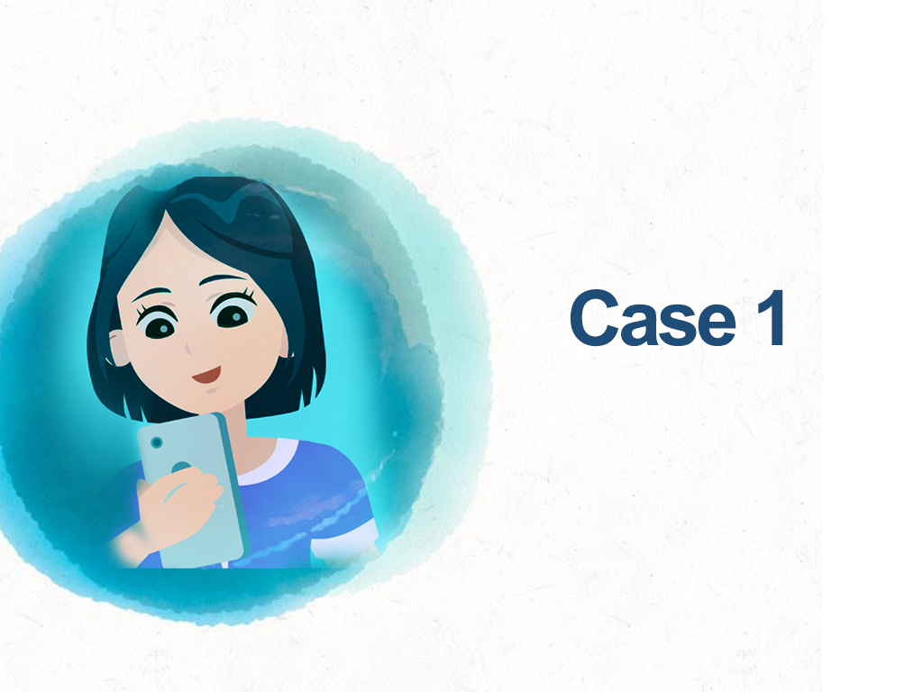

Slide 2
As technology advances, interpersonal interactions are no longer confined to face-to-face communication…

Slide 3
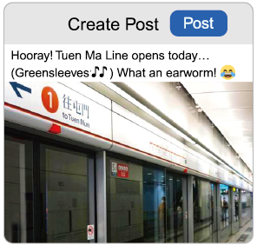
In Daily Life…

Slide 4
A social media post that leaves the strongest impression

Slide 6
Do you agree with Miss Chow’s behaviour of posting about her daily life on social media and sharing it with friends (including students)? Why?
What are your thoughts on Miss Chow’s post about Mr Chan?

Slide 7
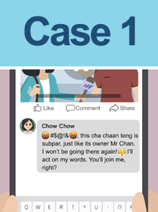
What do you think if the post is not written but only forwarded by Miss Chow?

Slide 8
The school codes/school-based policies in connection with teachers’ words and deeds as well as their information literacy…

Slide 9
Promote teachers’ professional ethics Be rational and respectful to others
Foster positive values in students by practicing what one preaches
Always be heedful of ones’ professional identity as teachers and mindful of ones’ words and deeds
Avoid making comments that are subjective, untrue, vulgar or convey incendiary ideas or strong hatred

